Slide 1
Image Search Engine
Project guide: Prof. Namita Pulgam

Slide 2
Introduction
Need of CBIR
What is CBIR
Goals of CBIR
Existing systems
Aims and objectives

Slide 3
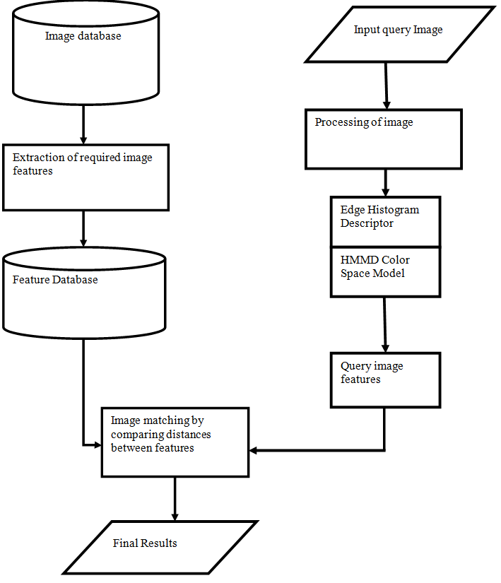
Proposed System

Slide 4
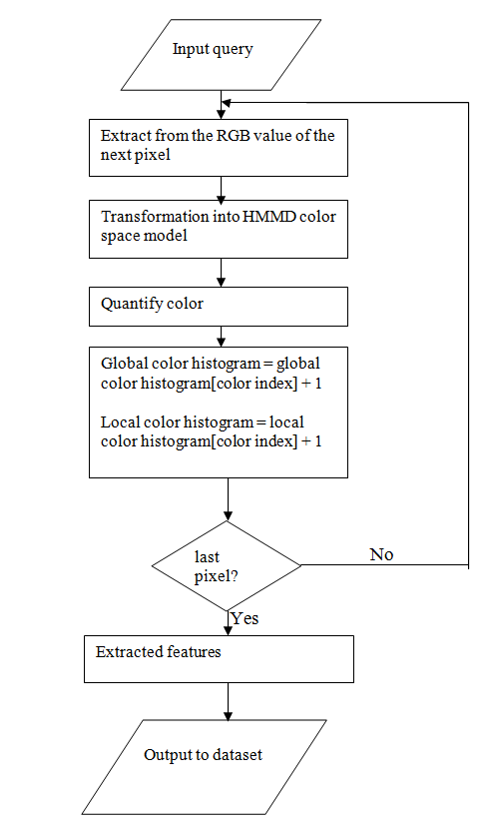
Hue Min Max Difference (HMMD)

Slide 5
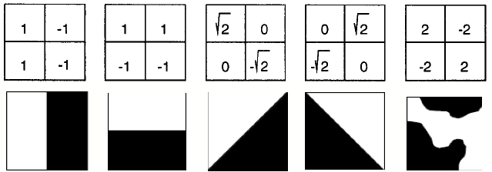
Edge Descriptor

Slide 6
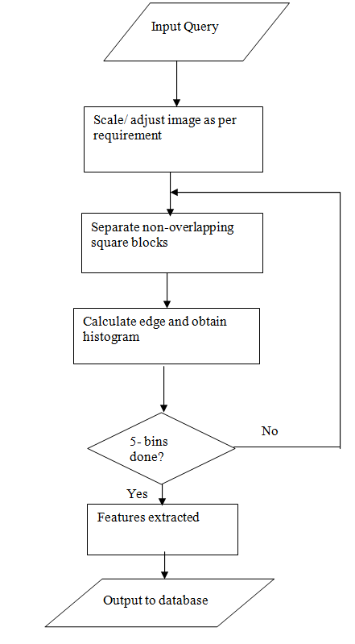

Slide 7
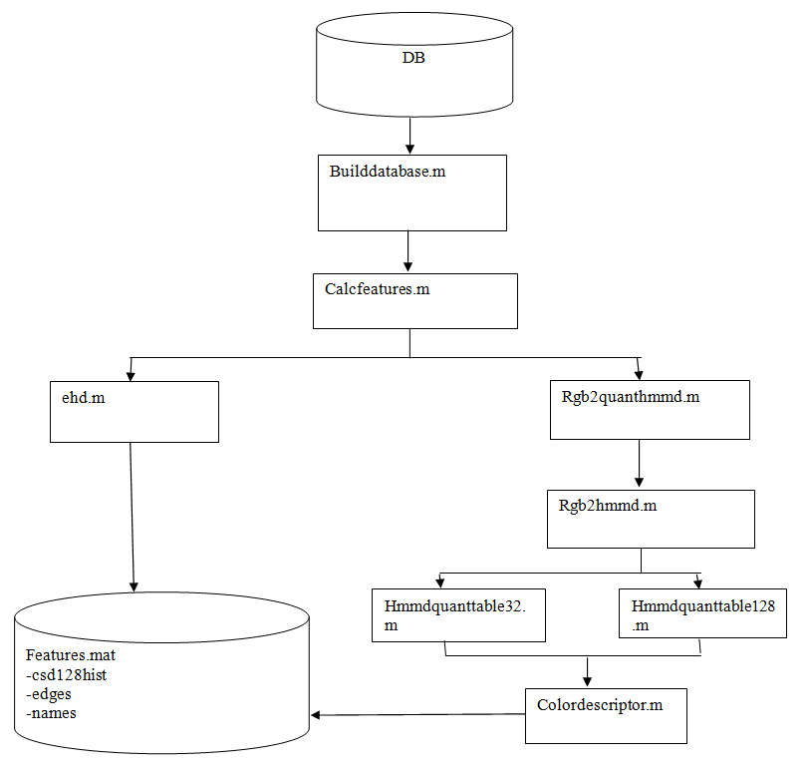
Build Database

Slide 8
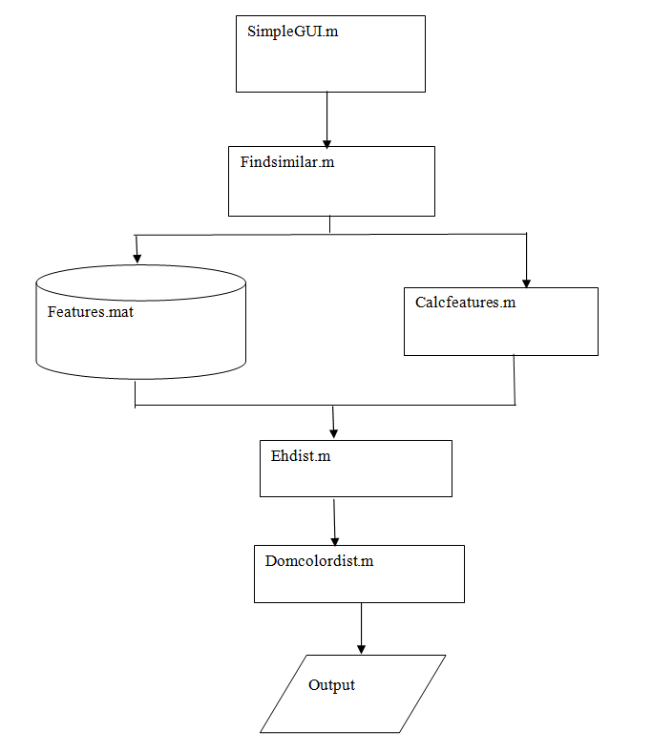
GUI

Slide 9
Analysis
The Average time taken for each image can be considered to be 2 seconds.
Our database consists of 2000 images.
Therefore,
Total time to preprocess
= average time per image * no. of images
= 2 seconds * 2000
= 4000 seconds
= 66.67 minutes
~ 1 hour 6 minutes.

Slide 10
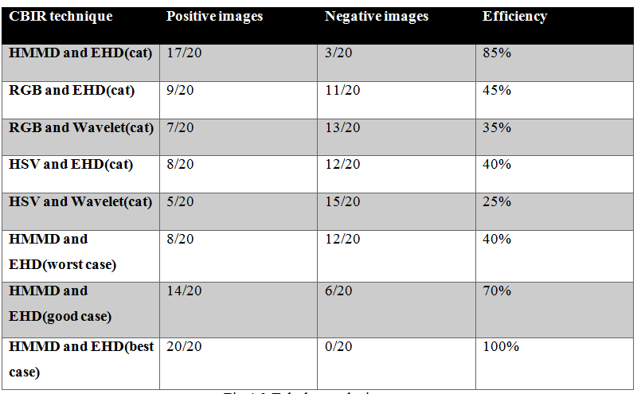

Slide 11
Future Work
Multiple Options
Image renaming
Feedback
Dedicated product

Slide 12
Conclusion
How is the system
Comments on EHD
Comments on HMMD
Union of the two
Anomalies

Slide 13
Thank You.

